Slide 1
Lecture 9 Object Oriented Programming and Design
Prof. Brendan Kochunas
10/2/2018
NERS 590-004

Slide 2
Outline
Quick Revisit of GMRES
Software Lifecycles for Computational Science and Engineering
Overview of Object Oriented Programming
OO Concepts & Nomenclature
Example: Sparse Matrix Storage formats
The Unified Modeling Language
Design Patterns

Slide 3
Learning Objectives
Understand “maturity” and metrics for CSE software
Know the basic object-oriented program concepts
Learn the basics of UML and its relationship to OO Software design.
Understand what design patterns are and how they may be used in scientific computing

Slide 4
Revisiting GMRES

Slide 5
Software Lifecycles

Slide 6
Software Lifecycle Model
What is it?
What should a Lifecycle model do?
The model used to decide when to perform particular development activities
Implicit to all software projects
Not necessarily formally defined.
Much better to have a formally defined lifecycle model.
Will define “maturity levels”
Also defines what activities to perform at each level
Allow exploratory research to remain productive
Don’t require more work than necessary in early phases of basic research
Enable reproducible research
Required for credible peer reviewed research
Improve overall development productivity
Focus on right software engineering practices at the right time. Minimize overhead
Improve production software quality
Focus on foundational issues first. Build on quality with quality
Communicate maturity levels more clearly to customers
Manage user expectations
Notes:
Description summarizes TriBITS Software Lifecycle Model
https://doi.org/10.2172/1038225

Slide 7
Example of “Validation-Centric” Lifecycle Model (What you may be familiar with)
Validation is “doing the right thing”
Software product is viewed as “black box” that is supposed to do the right thing.
Not generally concerned with the internal structure of the program
Can be very efficient because it has little overhead initially.
Usually more difficult to maintain long term
Software is poorly designed
Difficult to detect changes (no automated testing)
Little to no planning
Elicit Requirements (e.g. solve Ax=b)
Write the software
(usually design as you go) (debug as you go) (manually test as you go)
Maintain (It works. It’s done) (Don’t need to add any new features)
As much as 75% or more of total cost in a software project can be maintenance!
Notes:
Ultimately Costs much more.
In many cases leads to early abandonment.

Slide 8
TriBITS Lifecycle Model: Maturity Levels
Exploratory/Experimental (EX)
Primary purpose is to explore alternative approaches and prototypes
Little to no testing or documentation
Not to be included in a release
Very likely code will end up in recycle bin
Research Stable (RS)
Strong unit and verification tests
Very good line coverage in testing
Has a clean design
May not be optimized
May lack “robustness” and complete documentation
Production Growth (PG)
Includes all good qualities of RS code
Improved checking for bad inputs
More graceful error handling
Good documentation
Integral and regression testing
Production Maintenance (PM)
Includes all good qualities of PG code
Primary development activities are bug fixes, performance tweaks, and portability.
Unspecified (UM)
Provides no official indication of maturity

Slide 9
Maturity of Software Quality Metrics (Ideal)
Figure 1. “Typical levels of various production quality metrics in the different phase of the proposed Lean/Agile-consistent TriBITS lifecycle model”
From R. Bartlett, et al., “TriBITS Lifecycle Model” Version 1.0,” SAND2012-0561, (2012)

Slide 10
Maturity of Software Quality Metrics (Unfortunate Reality)
This is what will happen if your team is not disciplined!
Figure 6. “Example of the more typical variability in key quality metrics in a typical CSE software development process.”
From R. Bartlett, et al., “TriBITS Lifecycle Model” Version 1.0,” SAND2012-0561, (2012)

Slide 11
Summary
Development Processes:
Software Development consists of:
Add overhead, but will frequently save you time in the long term
Require discipline
provide software quality assurance
may need to be tailored to your situation.
Problem Definition
Requirements
Architecture
High-level design
Low-level design
Testing

Slide 12
Object Oriented Programming
Basis for a lot of modern programming (wait... why?)
Improves code reusability
Keep data and operations on that data “close together”
In working through OO design, you may find yourself talking like someone who has “lost their marbles” or a philosopher.
e.g. What does it mean to be “a file”?

Slide 13
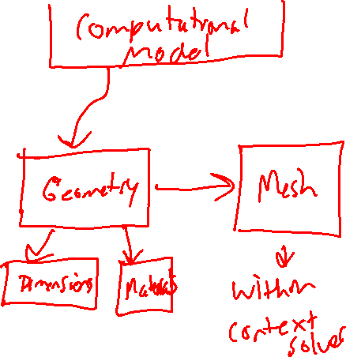
Abstraction
Example
Abstraction is the idea of simplifying a concept in the problem to its essentials within some context
Rely on the rule of least astonishment
Capture the essential attributes with no surprises and no definitions that go beyond the scope of the context
This is the process by which you develop classes and their attributes.

Slide 14
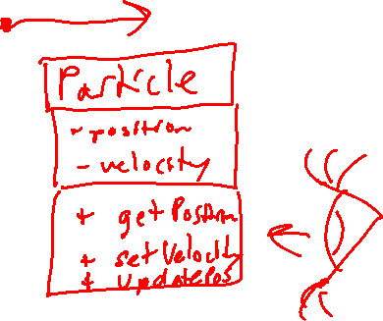
Encapsulation
Example
Encapsulation means to hide data
If you are used to procedural programming this means eliminating global variables
With strict encapsulation data is only passed through interfaces
Advantage:
You can change the low-level design without having to update “client code”
Disadvantage:
Argument lists for interfaces can become long, although this can be mitigated.
Common practice: implement “accessor” functions
e.g. set & get
Notes:
Particle
-position
-velocity
+getPosition
+setVelocity
+updatePosition

Slide 15
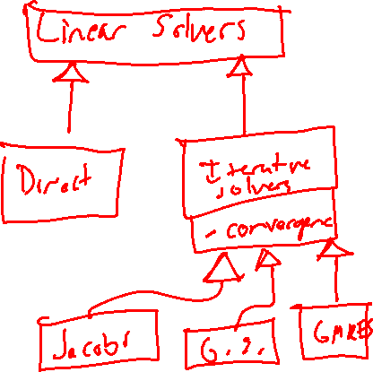
Inheritance
Example
Inheritance is a type of relationship between classes
Defines a parent-child relationship
Child class has attributes and methods of parent class
Facilitates code reuse
Key principle: do not repeat yourself
Results from generalization of concepts
Can have single or multiple inheritance
Not all languages (e.g. Fortran) support multiple inheritance

Slide 16
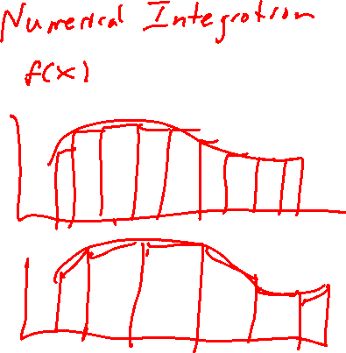
Polymorphism
Example
Polymorphism means to change behavior or representation
Facilitates extensibility for inheritance hierarchies.
Lets clients make fewer assumptions about dependent objects.
Decouples objects lets them vary relationships at run time
Several types of polymorphism
static – happens at compile-time
lower overhead
dynamic – happens at run-time
more flexibility
Notes:
Numerically integrate a function
-histogram
-trapezoid rule
-Simpson’s rule
-Quadrature

Slide 17
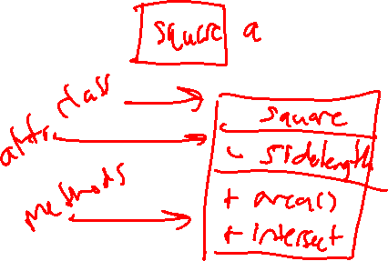
Classes, Attributes, and Methods
Example
In object oriented programming, objects are typically referred to or implemented as “classes”.
A class is a collection of attributes and methods
attributes are data (or variables)
methods are operations (or procedures)
In good object oriented design:
attributes are typically private or only used by the object itself
methods are typically public and other code interacts with the object through its methods
What is it? (answer is attributes)
What does it do? How is it used? (answer is methods)
Notes:
Square
side_length
area
intersect

Slide 18
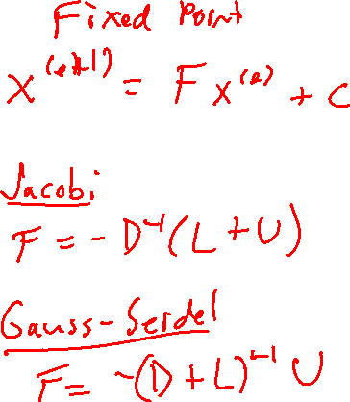
Abstract vs. Concrete Objects
Example
Abstract objects may have incomplete definitions
Abstract methods have no defined implementation (e.g. low-level design)
Just an interface definition
Abstract methods can only be defined on abstract objects
Abstract types can be used to define requirements of concrete types
Notes:
Fixed point iteration is abstract
Jacobi and Gauss-Seidel are concrete

Slide 19
OO Rosetta Stone for C++ and Fortran
From "Scientific Software Design: The Object-Oriented Way", Damian Rouson, Jim Xia, and Xiaofeng Xu

Slide 20
Implementation Examples

Slide 21
Encapsulation & Polymorphism (C++)
Operator Overloading
Function Overloading
Define extra operations for intrinsic operators (e.g. +, -, *, =, etc.)
Same idea as function overloading, but functions have special names
Use same function name, but with different arguments
#include <iostream>
using namespace std;
class printData
{
public:
void print(int i) {
cout << "Printing int: " << i << endl;
}
void print(double f) {
cout << "Printing float: " << f << endl;
}
void print(char* c) {
cout << "Printing character: " << c << endl;
}
};
int main(void)
{
printData pd;
pd.print(5); // Call print to print integer
pd.print(500.263); // Call print to print float
pd.print("Hello C++"); // Call print to print character
return 0;
}
class Point
{
public:
Point operator+(const Point& p) {
Point point;
point.x = this->x + b.x;
point.y = this->y + b.y;
}
private:
double x;
double y;
};
int main(void)
{
Point p1,p2;
p1 = p1 + p2;
}

Slide 22
Encapsulation and Polymorphism (Fortran)
Operator Overloading
Function Overloading
MODULE Points
TYPE :: Point
REAL(8) :: x,y
ENDTYPE
INTERFACE OPERATOR(+)
MODULE PROCEDURE add_Point
ENDINTERFACE
CONTAINS
FUNCTION add_Point(p1,p2) RESULT(p)
TYPE(Point),INTENT(IN) :: p1,p2
TYPE(Point) :: p
p%x=p1%x+p2%x
p%y=p1%y+p2%y
ENDFUNCTION
ENDMODULE
MODULE printData
INTERFACE print
MODULE PROCEDURE print_int
MODULE PROCEDURE print_double
MODULE PROCEDURE print_char
ENDINTERFACE
CONTAINS
SUBROUTINE print_int(i)
INTEGER,INTENT(IN) :: i
WRITE(*,*) i
ENDSUBROUTINE
SUBROUTINE print_double(d)
REAL(8),INTENT(IN) :: d
WRITE(*,*) d
ENDSUBROUTINE
SUBROUTINE print_char(c)
CHARACTER(LEN=*),INTENT(IN) :: c
WRITE(*,*) c
ENDSUBROUTINE
ENDMODULE

Slide 23
Example: Sparse Matrix Storage

Slide 24
Sparse Matrix Storage Formats: COOrdinate Storage

Slide 25
Sparse Matrix Storage Formats: Compressed Sparse Row (CSR) Storage

Slide 26
Sparse Matrix Storage Formats: ELLPACK Storage

